Slide 1
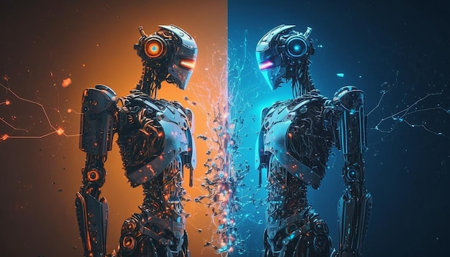

AI-Generated Media Detection
Under Supervision :
Dr. Eman Abdel-Latef .
Eng. Sahar.

Slide 2
Team Members
Abd-Allah Mohamed Abdel-monem.
Ahmed Mohamed Ali Abo el-Kassem.
Mohamed Abd-Allah Abdel-salam Abdel-Dayem.
Mohannad Ayman Salah Abdel-Fattah.
Rawan Abdel-Aziz Ahmed Mahmoud.
Reham Moustafa Ali Abdel-Moati.
Romani Nasrat Shawqi Gerges.
Sara Reda Moatamed Hassan.
Zeyad Elsayed Abdel-Azim Ali Yousif.

Slide 3
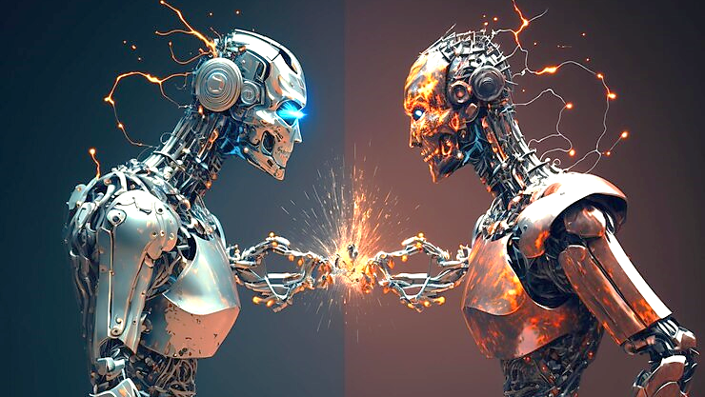
Agenda
Problem Definition.
Problem Solution .
Project Design.
Models .
UI Design.
Tools.

Slide 4
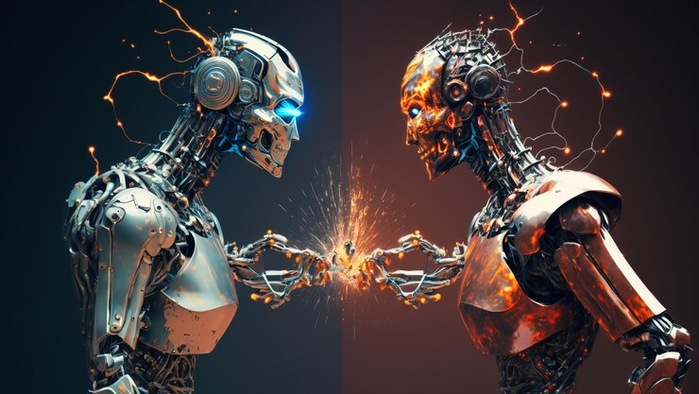
Problem Definition

Slide 5
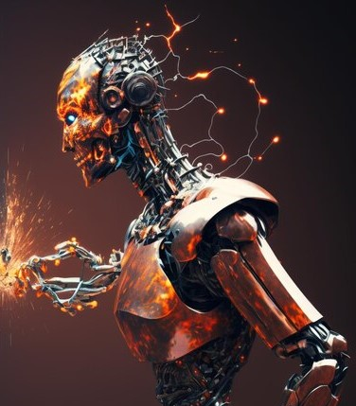
Problem Definition
Problem Statement:
Addressing challenges in media authenticity due to deepfake technology.
Risks include misinformation, privacy breaches, and malicious intent.
Project Overview:
AI Detection System for Multiple Media.
Aims to tackle manipulation in text, images, and deepfake photos.

Slide 6
Problem Definition
Key Objectives:
Text Analysis: Uncovering deceptive language and misinformation.
Image Detection: Identifying manipulated elements in images.
Deepfake Photo Recognition: Detecting and mitigating the impact of deepfake photos.

Slide 7
Problem Definition
Technical Aspects:
Leveraging cutting-edge technologies for comprehensive solutions.
Advanced algorithms for image and deepfake analysis.
Methodologies:
Detailed analysis of textual content for deception.
Image analysis techniques for identifying manipulation.
State-of-the-art algorithms for deepfake detection.

Slide 8
Problem Solution

Slide 9
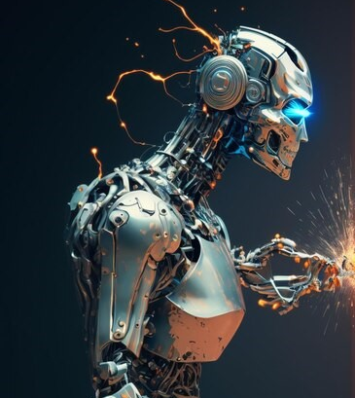
Project Introduction
AI Detection System for Multiple Media ,Our graduation project focuses on developing an advanced AI detection system capable of discerning authenticity across various media types text, images, and deepfake photos. Leveraging cutting-edge technologies, our system aims to provide a comprehensive solution to the escalating concerns surrounding manipulated content.

Slide 10
Project Introduction
Key Objectives:
Text Analysis: Uncovering deceptive language and misinformation in textual content.
Image Detection: Identifying manipulated elements within images through advanced image analysis.
Deepfake Photo Recognition: Employing state-of-the-art algorithms to detect and mitigate the impact of deepfake photos.

Slide 11
Project Introduction
Significance:
Preserving Trust: Enhancing trust in digital media by ensuring authenticity.
Mitigating Harm: Preventing the potential harm caused by misinformation and manipulated content.
Contributing to AI Ethics: Upholding ethical standards in the development and deployment of AI technologies.

Slide 12
Project Introduction
Goals:
Create a powerful detection system.
Contribute to ethical AI use in media.
User Education: Creating awareness programs to educate users about media manipulation risks.
Multimodal Integration: Integrating analysis across multiple modalities for enhanced accuracy.
Let's delve into the technical aspects and methodologies in the subsequent sections.

Slide 13

Project Design
Data Flow Diagram.
Entity Relationship Diagram.

Slide 14
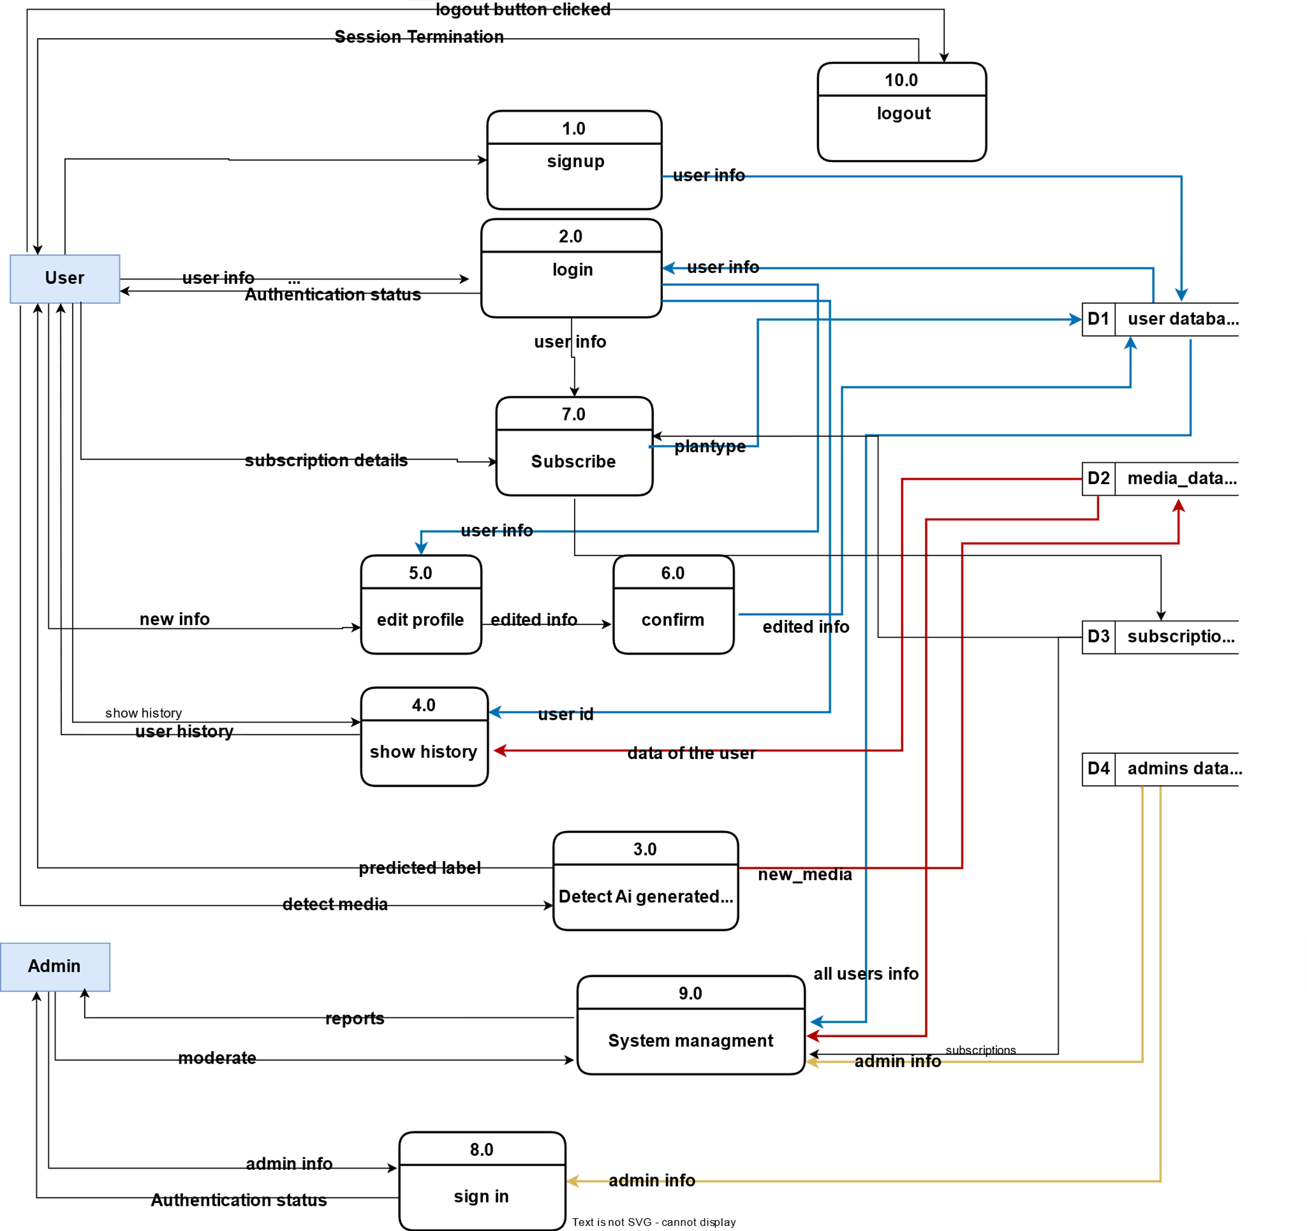
Data Flow Diagram
It is a graphical representation of the flow of data through a system, illustrating how data is input, processed, and output.
data flow diagram contains :
10 Process .
4 Data Stores.
2 External Entity.

Slide 15
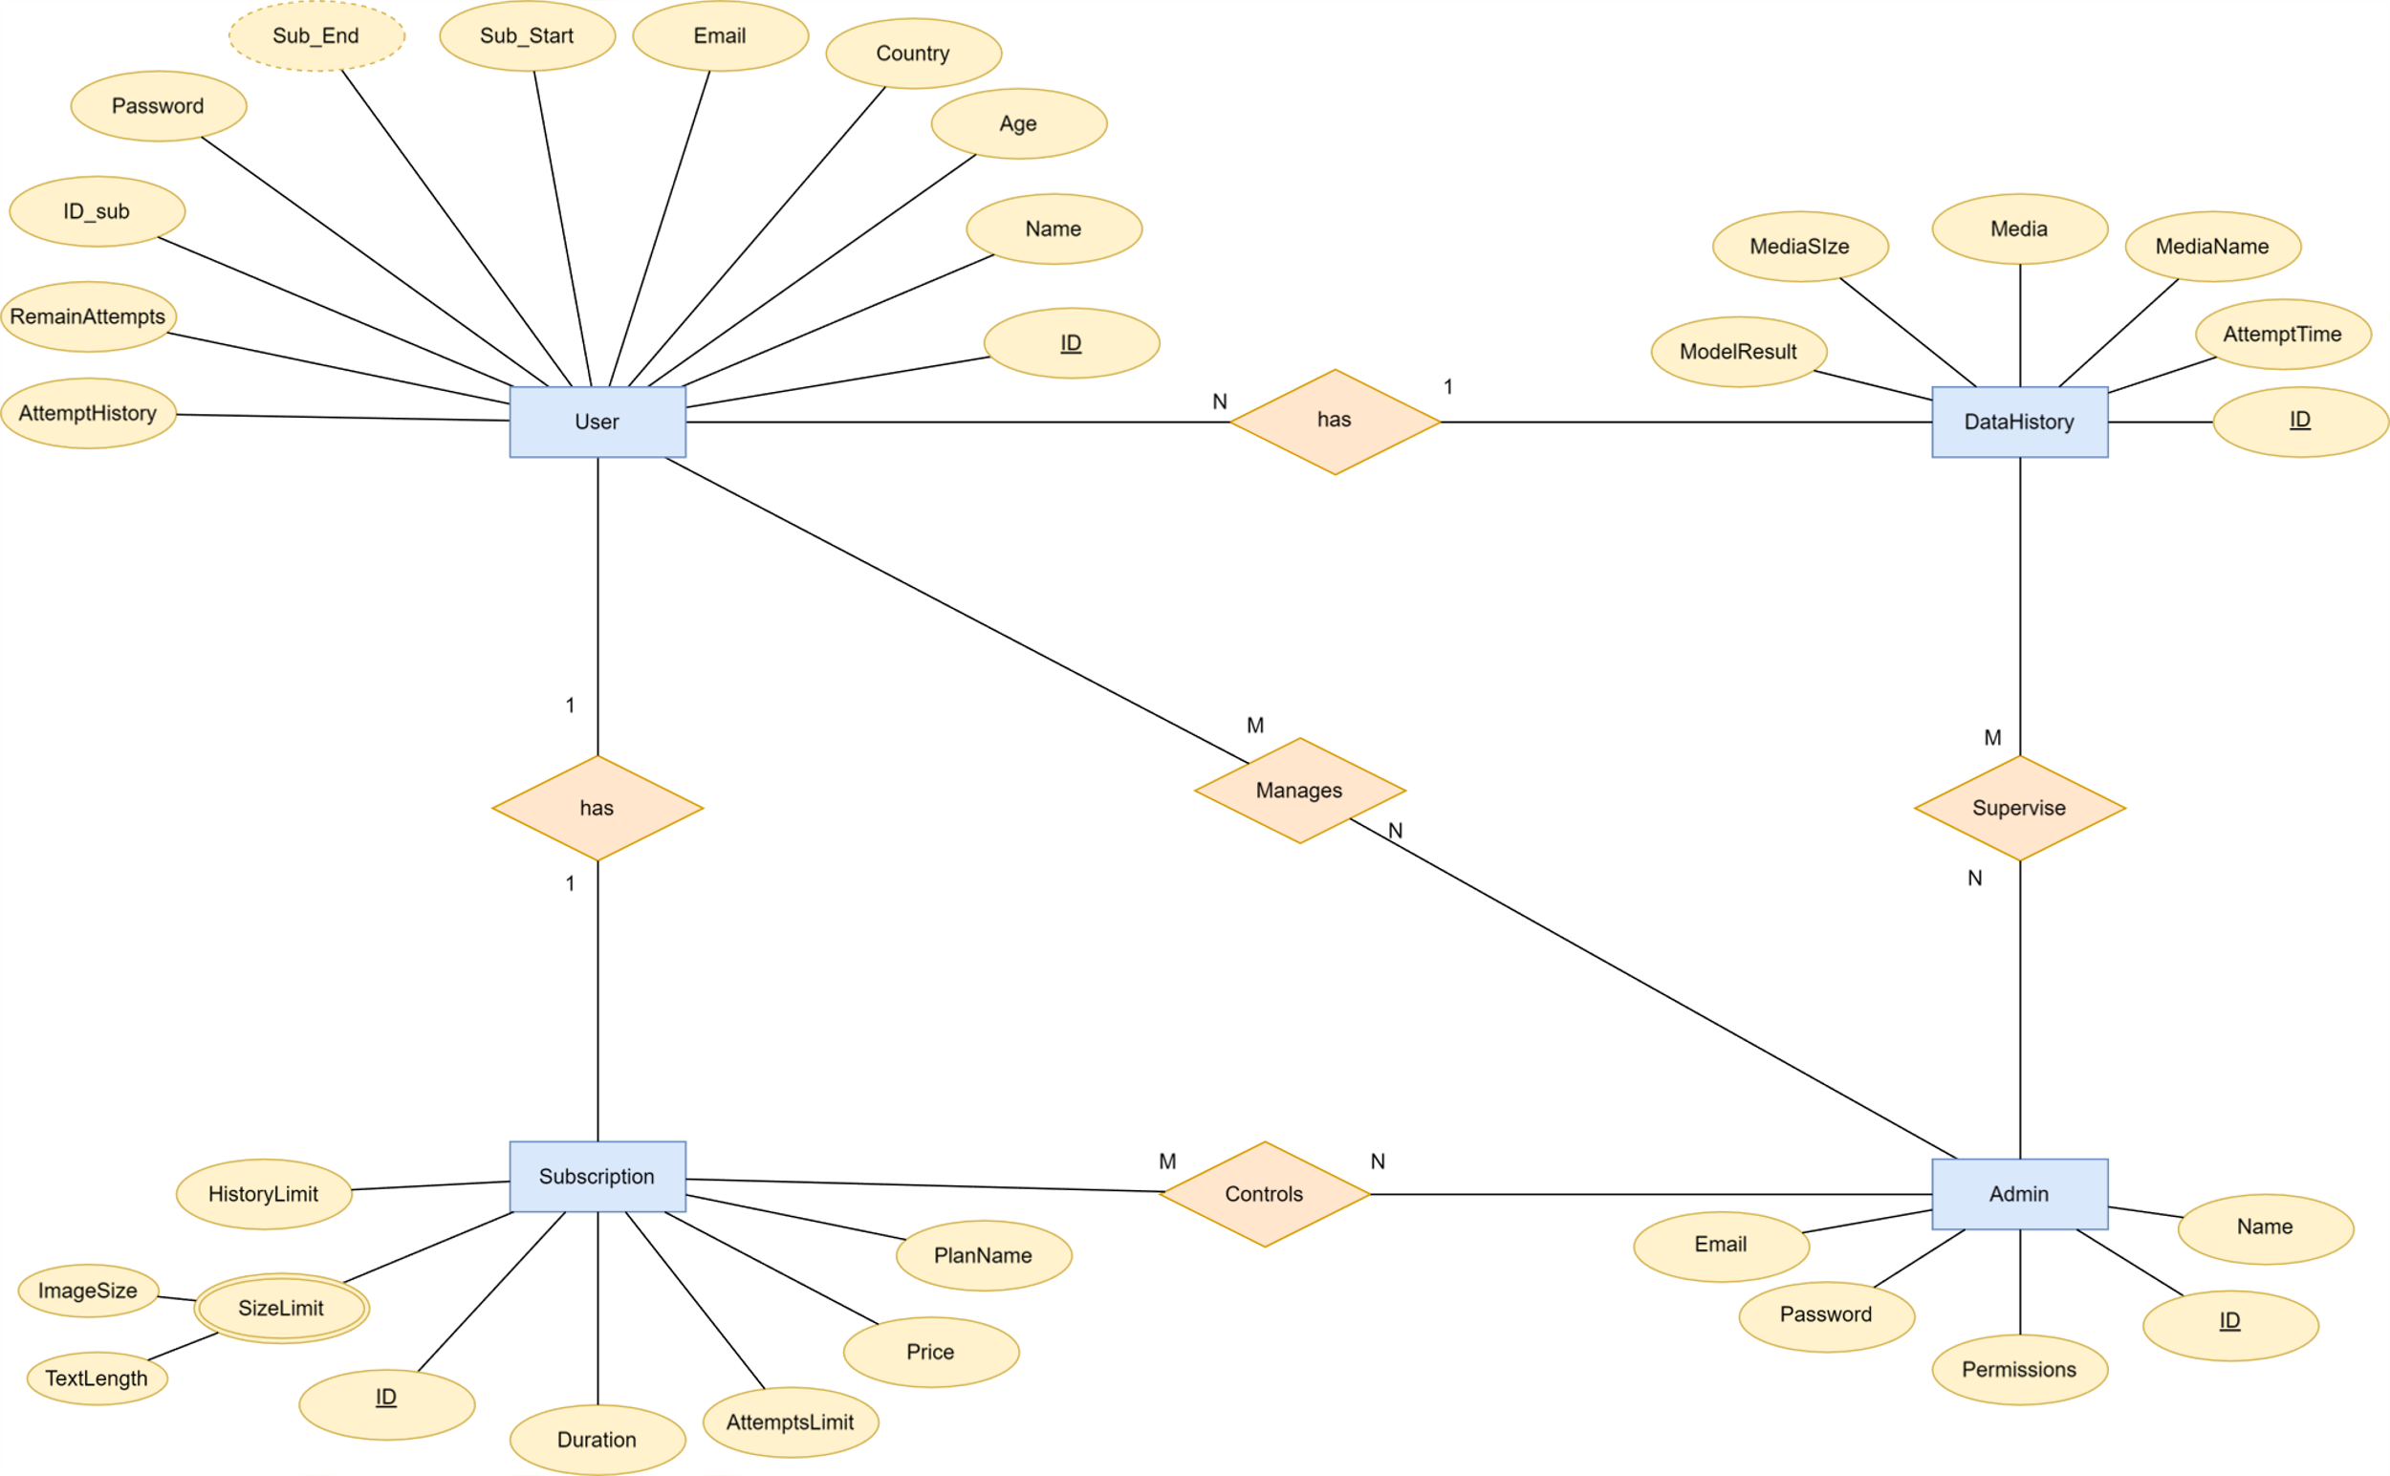
Entity Relationship Diagram
It is a visual representation of the data model that depicts the entities within a system and the relationships between them.
ERD contains 4 entities :
User.
Admin.
Subscription.
Data History.

Slide 16
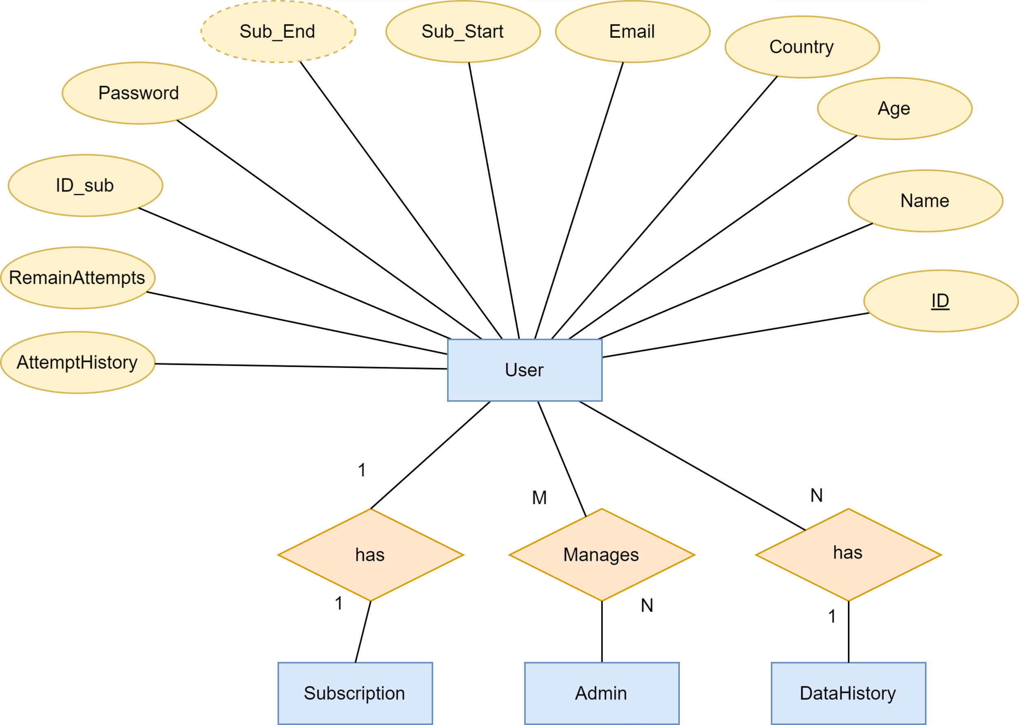
ERD(User)Cont...

Slide 17
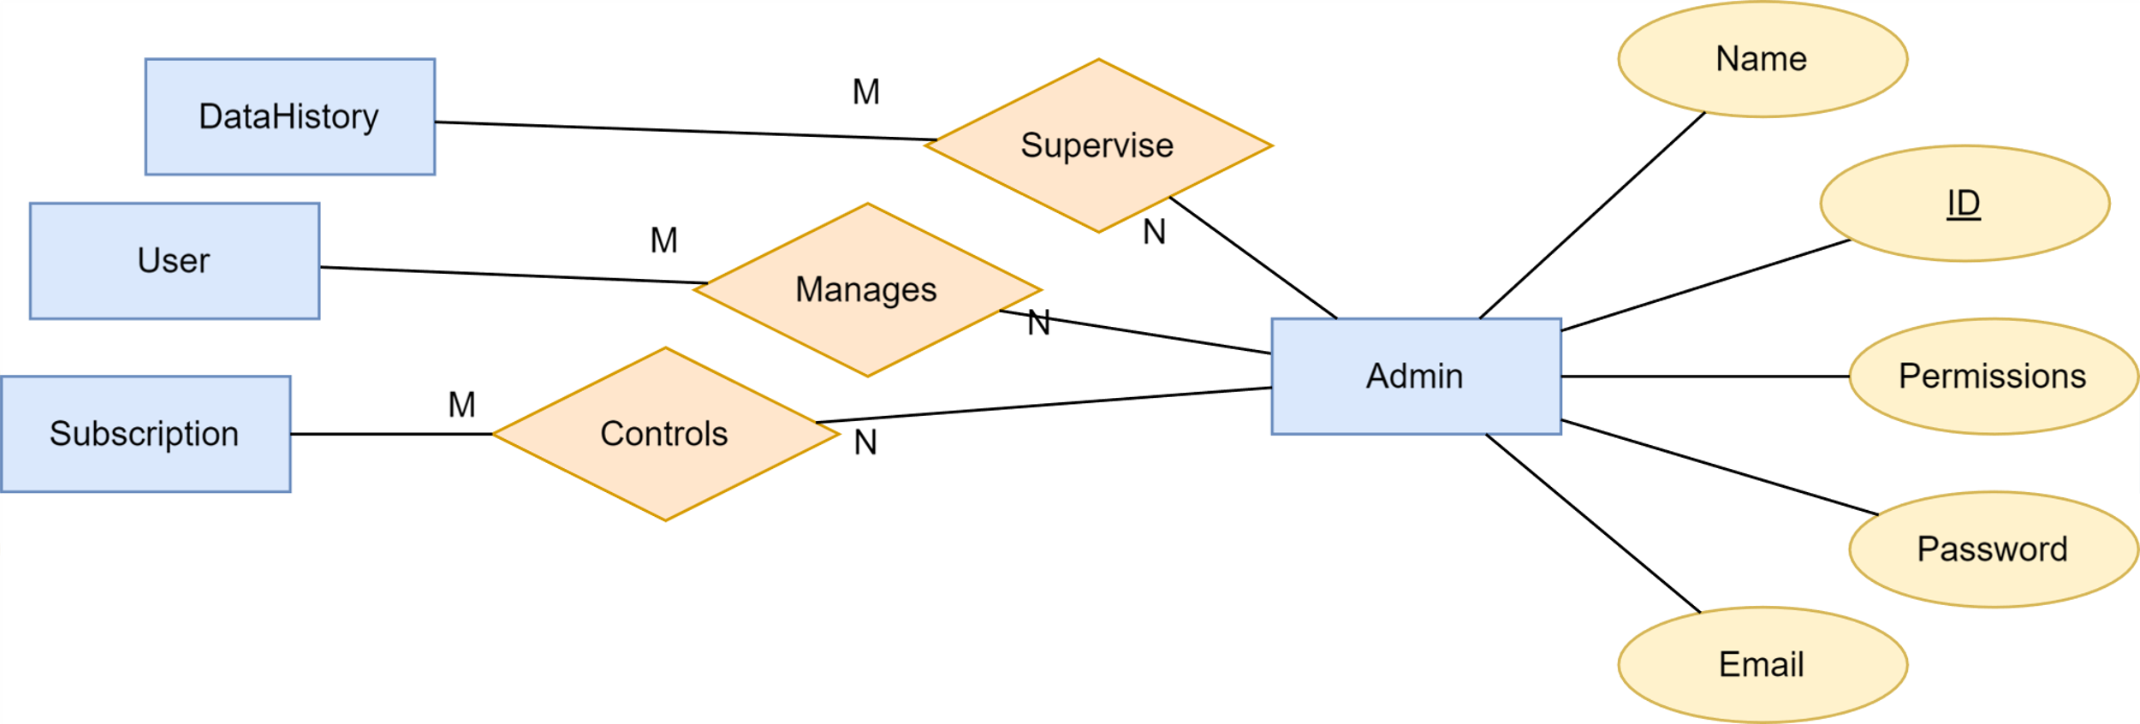
ERD(Admin)Cont...

Slide 18
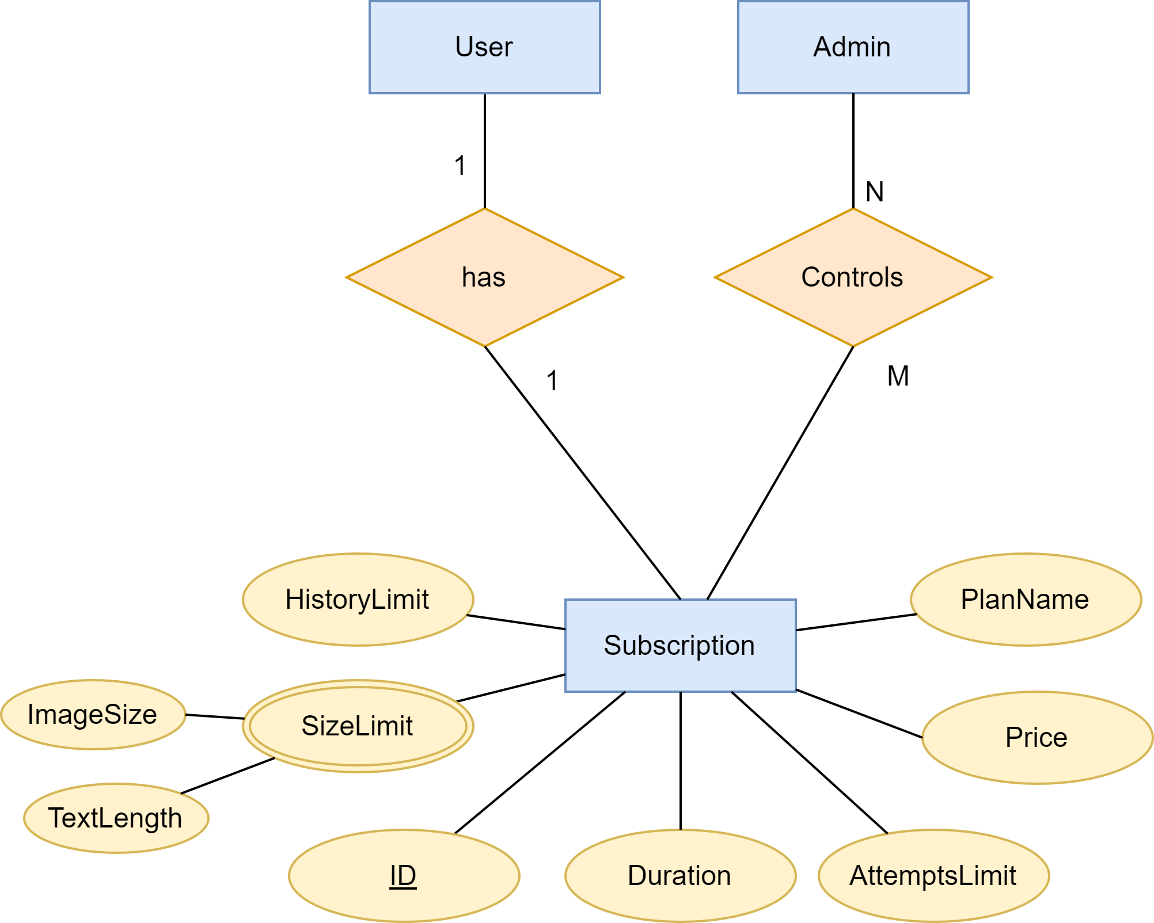
ERD(Subscription)Cont...

Slide 19
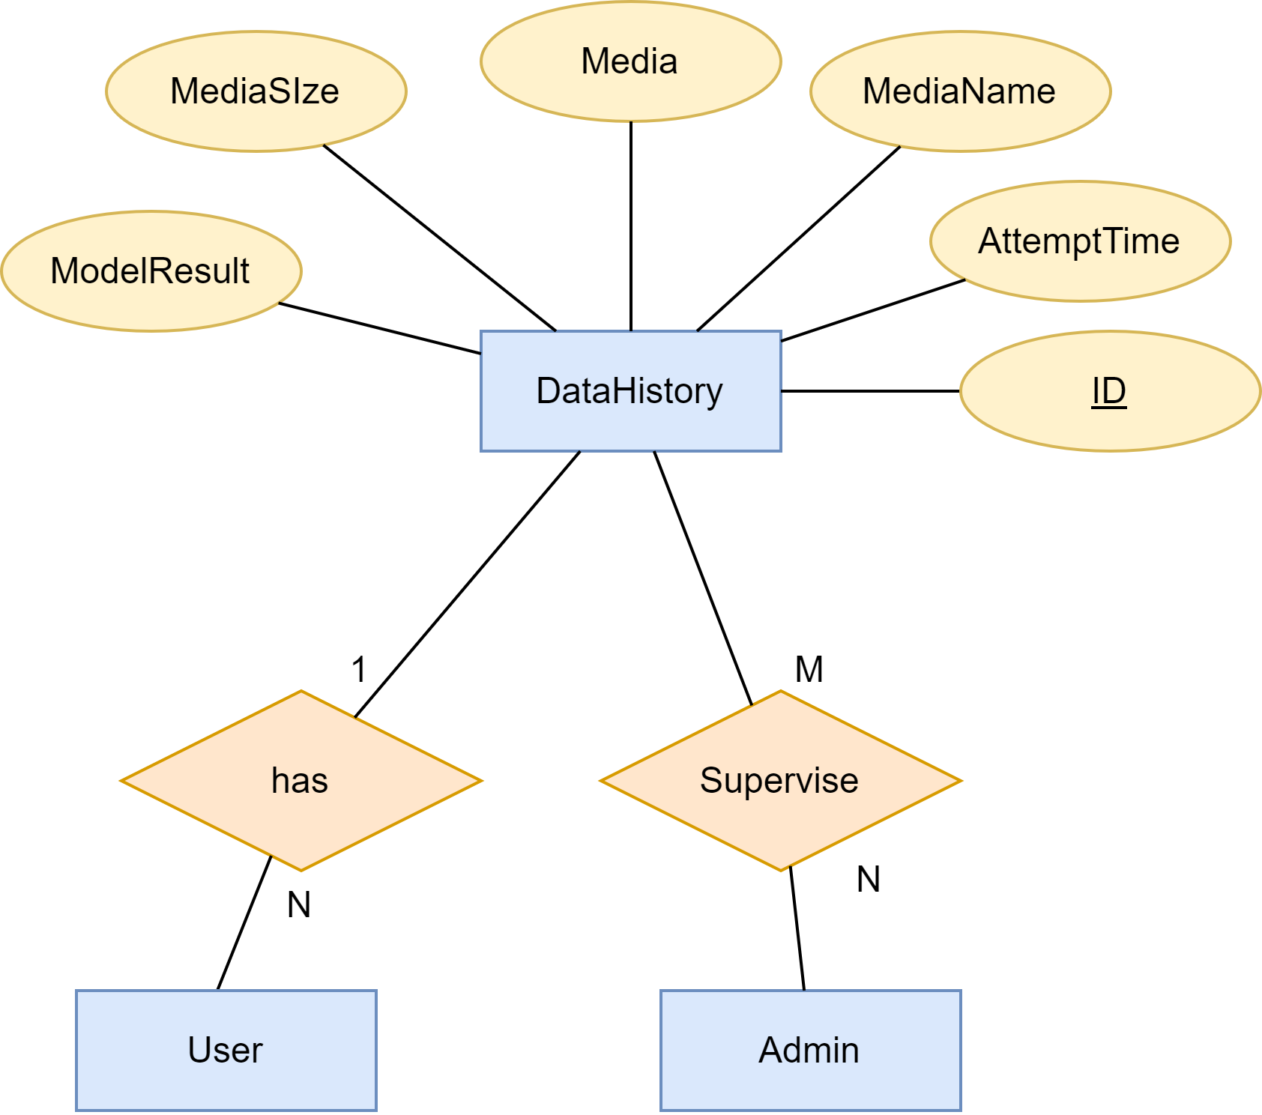
ERD(Data History) Cont...

Slide 20
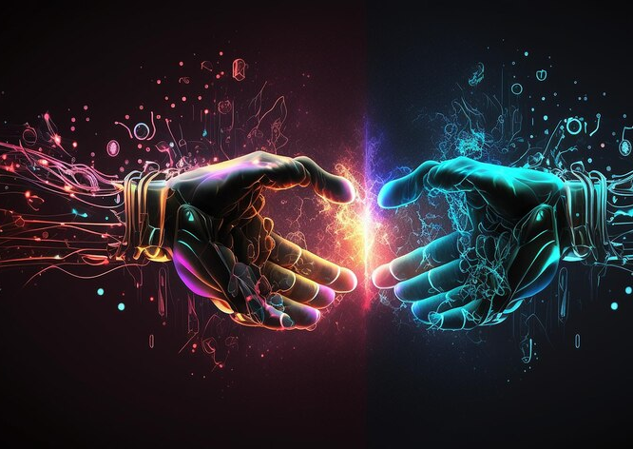
Models of Detection
Text detector .
Image generated detector .
Deepfake detector.

Slide 21
Text Detection Model
Large language Models (LLMs) can write things that are exactly like what people write, but it is difficult to know whether words come from a person or a machine.
This can be a problem for teachers who are checking whether students have done their own work or used these forms to finish assignments.
A text Detection model is a classification model that separates machine-generated text from human-written ones.
We are trying, using advanced neural network techniques and language models, to build an architecture capable of distinguishing between what was written by an AI and a human, and to be more robust in the face of adversarial attacks.

Slide 22
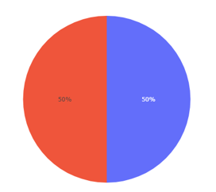
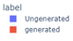
Text Detection Prototype Model
A prototype model was created using some deep learning and NLP techniques, including LSTM Bidirectional, on this data:
LLM - Detect AI Generated Text : It is a competition dataset comprises about 10,000 essays, some written by students and some generated by a variety of large language models (LLMs). But the number of data available to train the model is 1378 , all of which is written by students.
DAIGT Proper Train Dataset : We used some of this data files to train the model
So we have 19,986 essays, divided into:
9,993 essays by students .
9,993 essays of Text generated by ChatGPT, Llama and Falcon.

Slide 23
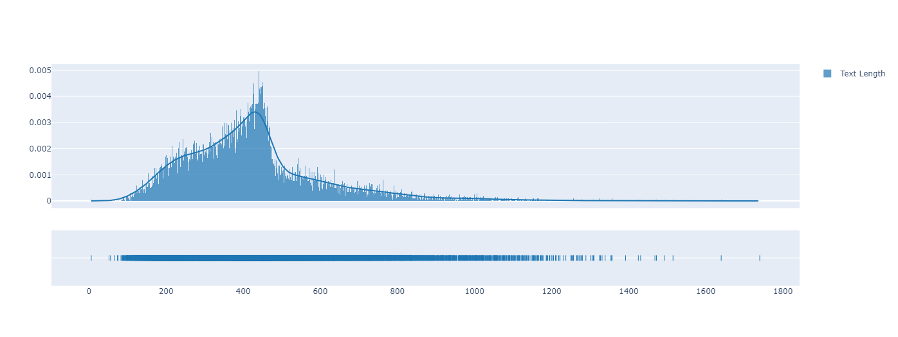
Text Detection Prototype Model(cont…)
This is a distribution of data across text length , from plot:
The Maximum length is 1740
The Minimum length is 6
Most of the lengths are between 427 and 450

Slide 24
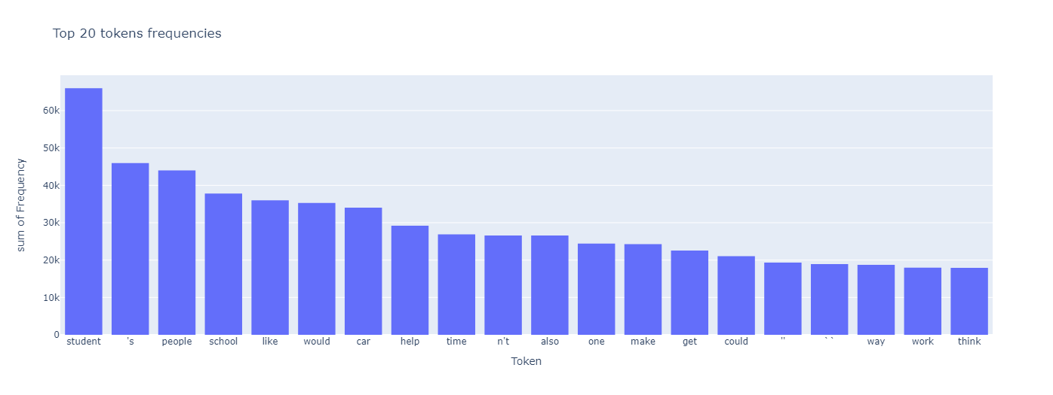
Text Detection Prototype Model(cont…)

Slide 25
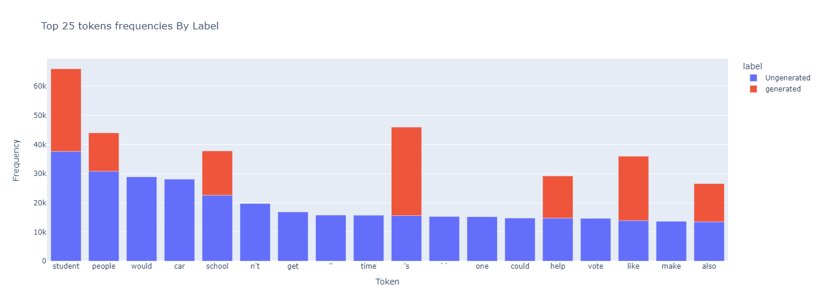
Text Detection Prototype Model(cont…)

Slide 26
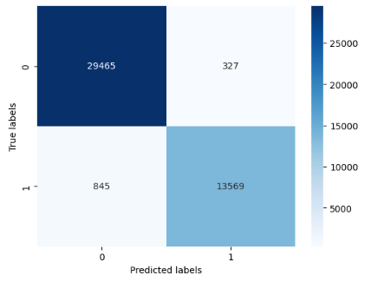
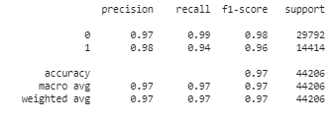
Text Detection Prototype Model(cont…)
Result of model :

Slide 27
Models of Detection
Text detector .
Image generated detector .
Deepfake detector.

Slide 28
Image generated detector .

Slide 29
Models of Detection
Text detector .
Image generated detector .
Deepfake detector.

Slide 30
Deepfake detector

Slide 31
Deepfake detector

Slide 32
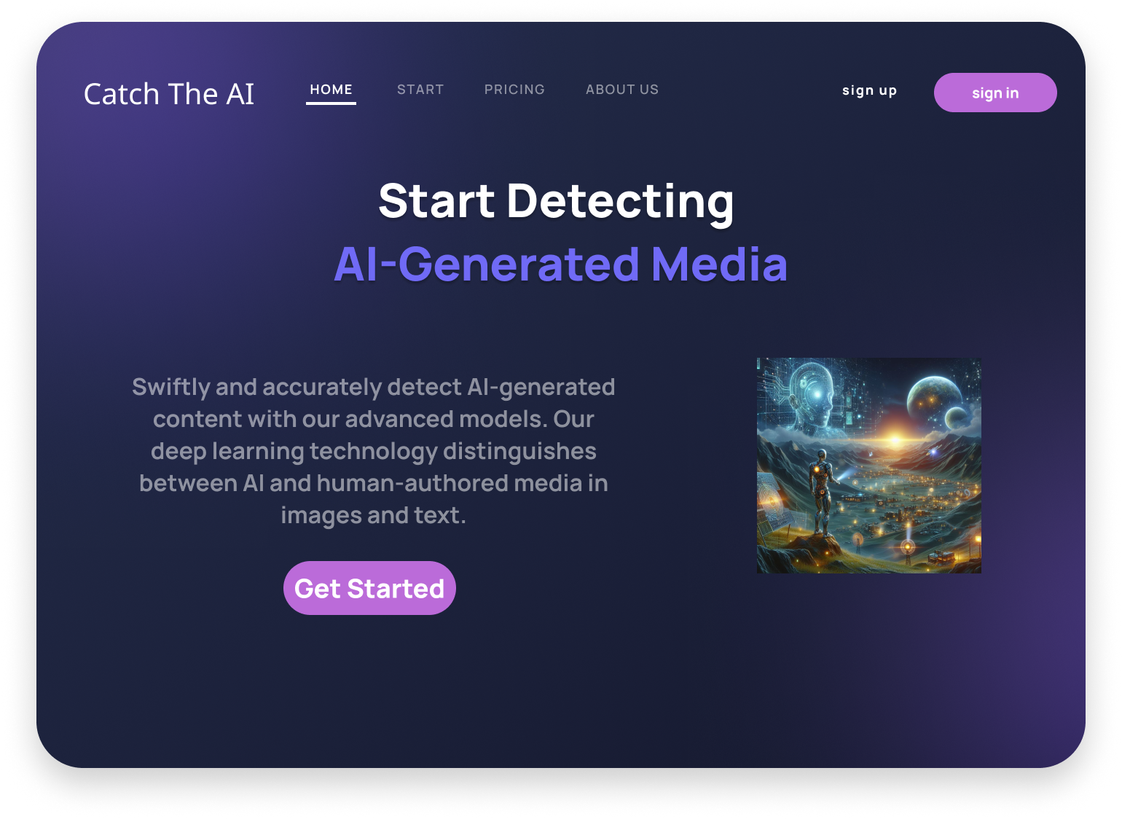
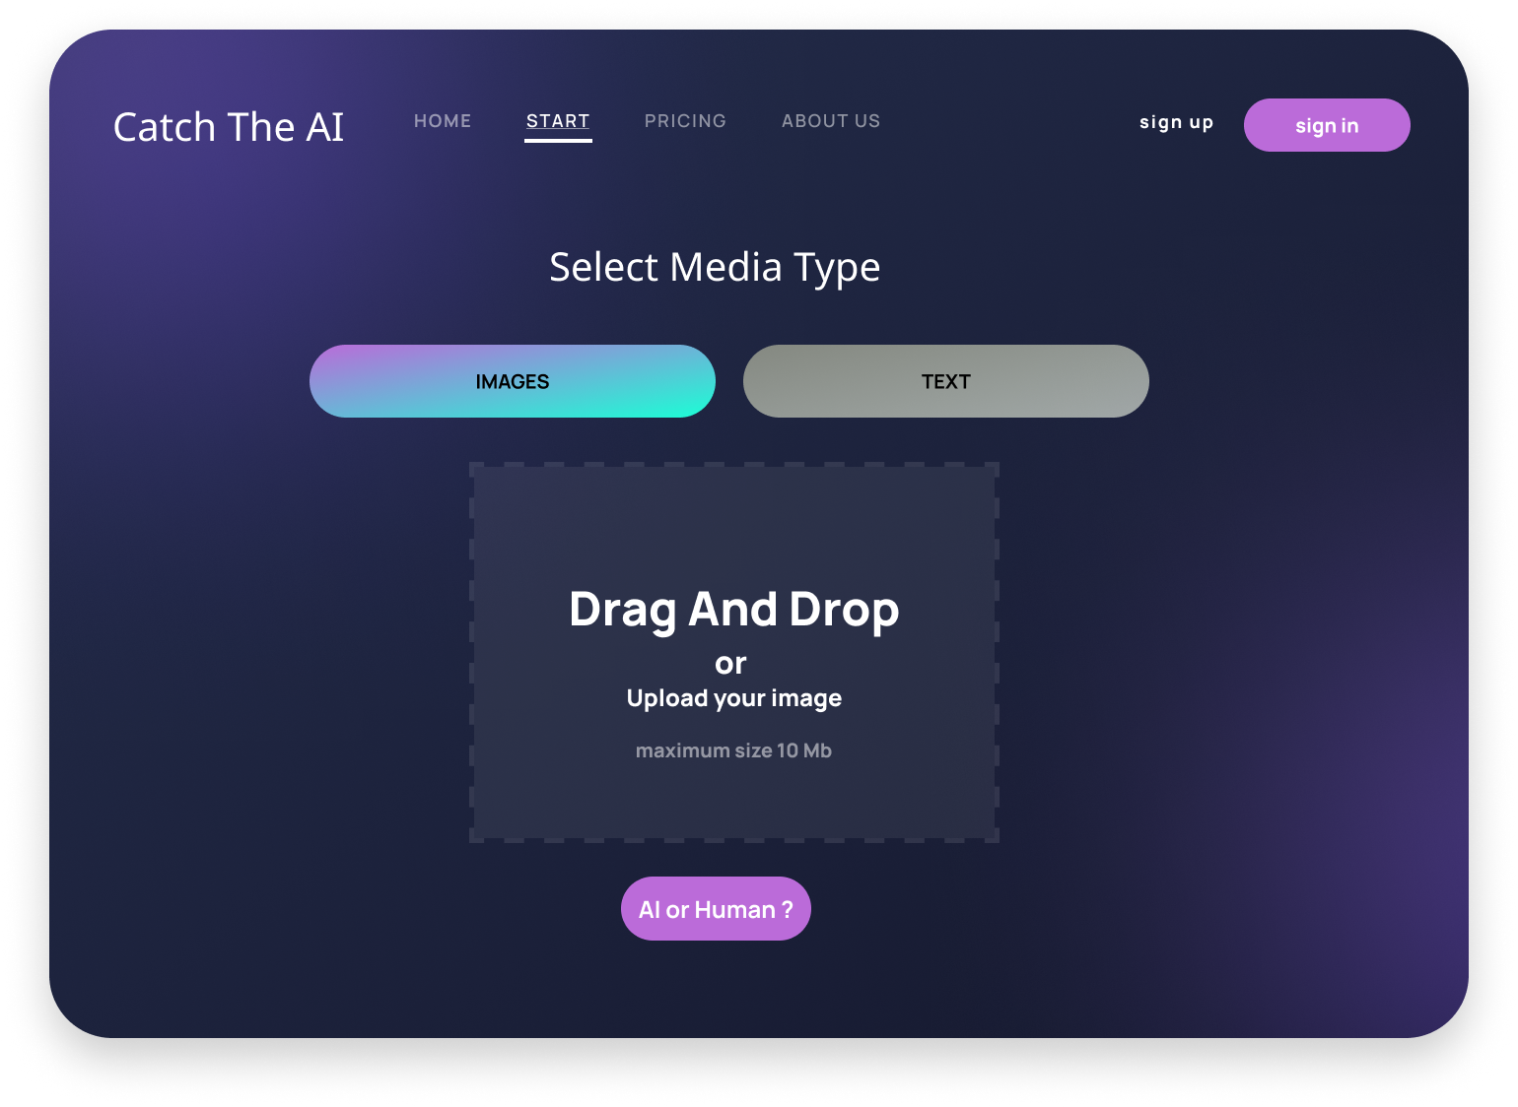



UI Design
Design for web pages

Slide 38



Tools

